Slide 1


Slide 2
Professional Software Development on the Fabric Platform

Slide 3
Informal Student Survey
What Languages?
JavaScript or TypeScript
C# or VB.NET
Python
Java
What else?
What development platforms?
Angular
React
.NET
Java
Node.js
Salesforce
What else?
What Source Control Systems?
GitHub
GitHub Enterprise
Azure Devs Ops
What else?

Slide 4
Agenda
Creating and Updating Items using the Fabric REST APIs
Automating Deployment using a Custom API-driven Pipeline
CI/CD – Development workflow with GIT
CI/CD – Deployment Options using GIT & Deployment Pipeline

Slide 5
Morning Agenda
Creating and Updating Items using the Fabric REST APIs
Getting started with the Fabric REST APIs
Programming with item definitions
Creating and managing connections
Understanding challenges with CI/CD in Fabric solution deployment
Configuring datasource paths using Deployment Parameters
Automating solution deployment using a custom API-driven pipeline
Deploying and Updating Workspace Items from a Source Workspace
Exporting Workspace Items in Exported Solution Format
Deploying and Updating Solutions from Exported Solutions

Slide 6
Best Practices with the Fabric REST APIs
Best practices with the Fabric REST APIs taught in this workshop
Using service principals when running deployment and update operations
Updating item definition files before using them to create and update workspace items
Using a substitution pattern to update and manage dependencies between workspace items
Using a parameterization pattern to automate deployment in multitenant scenarios
Creating connections and managing their associations with workspaces
Using notebooks and data pipelines to abstract data acquisition logic from deployment logic
Developing a custom API-driven pipeline to implement DEPLOY and UPDATE operations
Creating a custom export format for a Fabric solution composed of workspace items
Implementing DEPLOY and UPDATE operations for solution exports
Maintaining the 'source of truth' for a Fabric solution in GIT-enabled source control

Slide 7
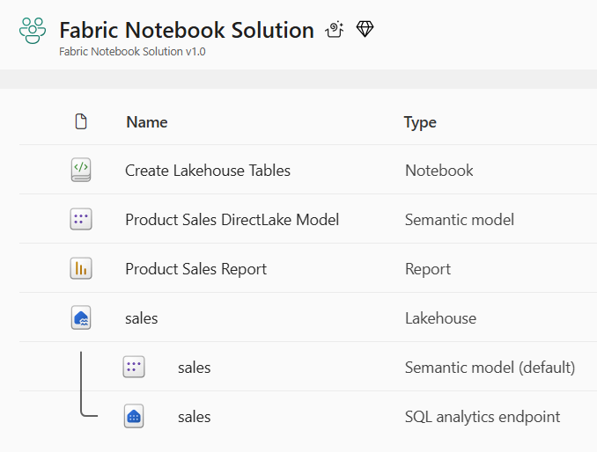
Motivation for Building Staged Deployments
Staged deployment used to push changes between environments like DEV>TEST >PROD
DEPLOY workflow creates downstream workspaces on demand
UPDATE workflow pushes out full update to all workspace items or partial update
DEPLOY and UPDATE workflows can cross environments such as Entra Id tenant boundaries
Entra Id tenant A
Entra Id tenant B
Entra Id tenant C
Dev Workspace
Test Workspace
Deploy
Items
Prod Workspace
Deploy
Items
Deploy
or
Update
Deploy
or
Update

Slide 8





Motivation for Multitenant Scenarios
Fabric provides development platform for building multi-tenant applications
Each customer tenant created using one or more Fabric workspaces
Developer uses Fabric REST APIs to create and configure workspaces and workspace items
Fabric Multi-tenant Environment
Entra Id Tenant Owned by ISV
Customer 1 Tenant Workspace
Customer 01
17 users
Lakehouse
Notebook
Semantic Model
Report
Custom
Multitenant Application
Customer 2 Tenant Workspace
Lakehouse
Notebook
Semantic Model
Report
Customer 02
85 users
Customer N Tenant Workspace
Lakehouse
Notebook
Semantic Model
Report
Customer N
450 users

Slide 9
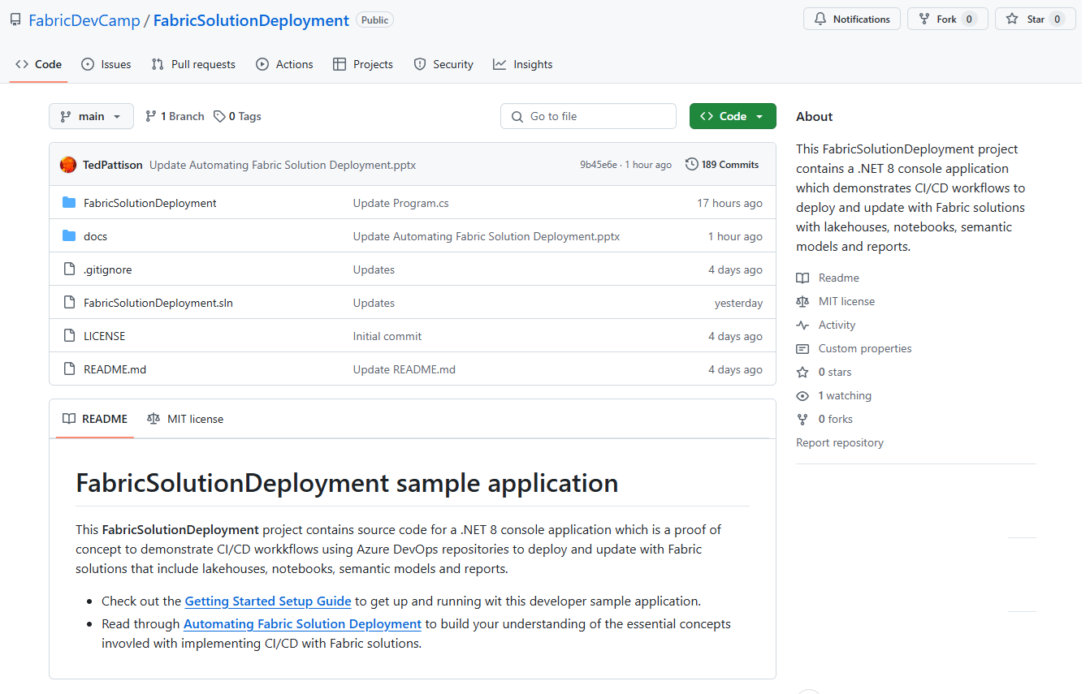
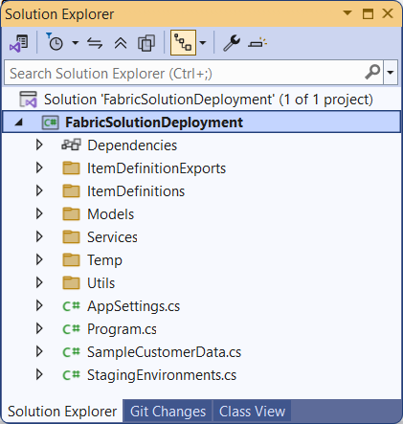
Developer Sample #1: FabricSolutionDeployment
Sample application demonstrating how to implement solution deployment workflows
Available at https://github.com/FabricDevCamp/FabricSolutionDeployment
Created as a .NET 8 console application using the Fabric REST API .NET SDK
Provides easy learning path for developers to download project and get up and running

Slide 10
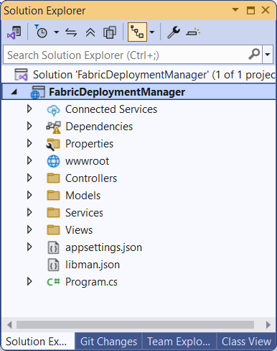
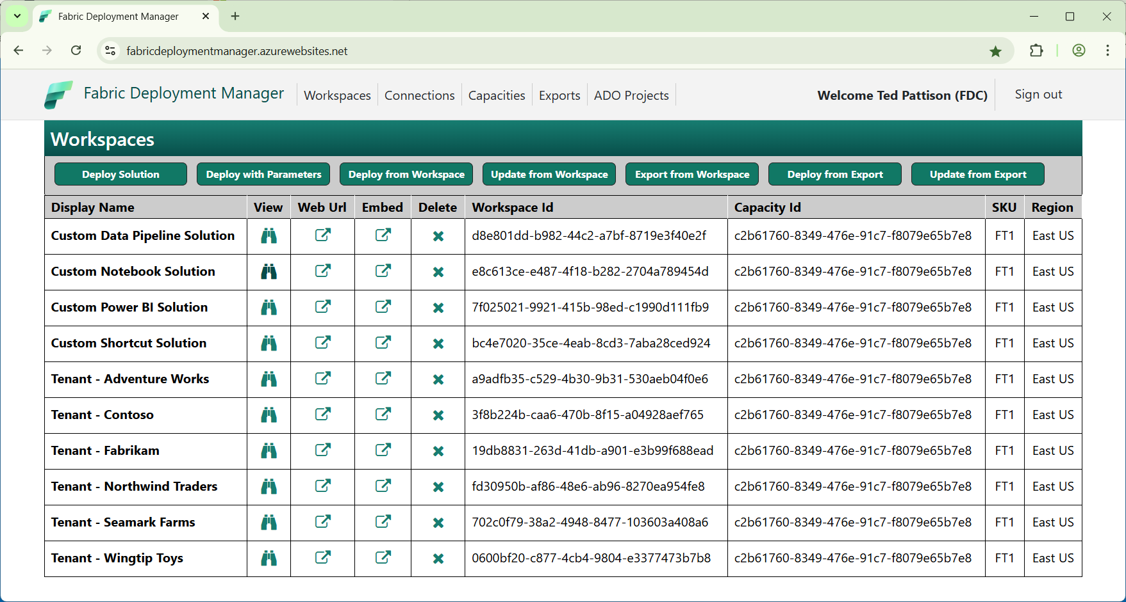
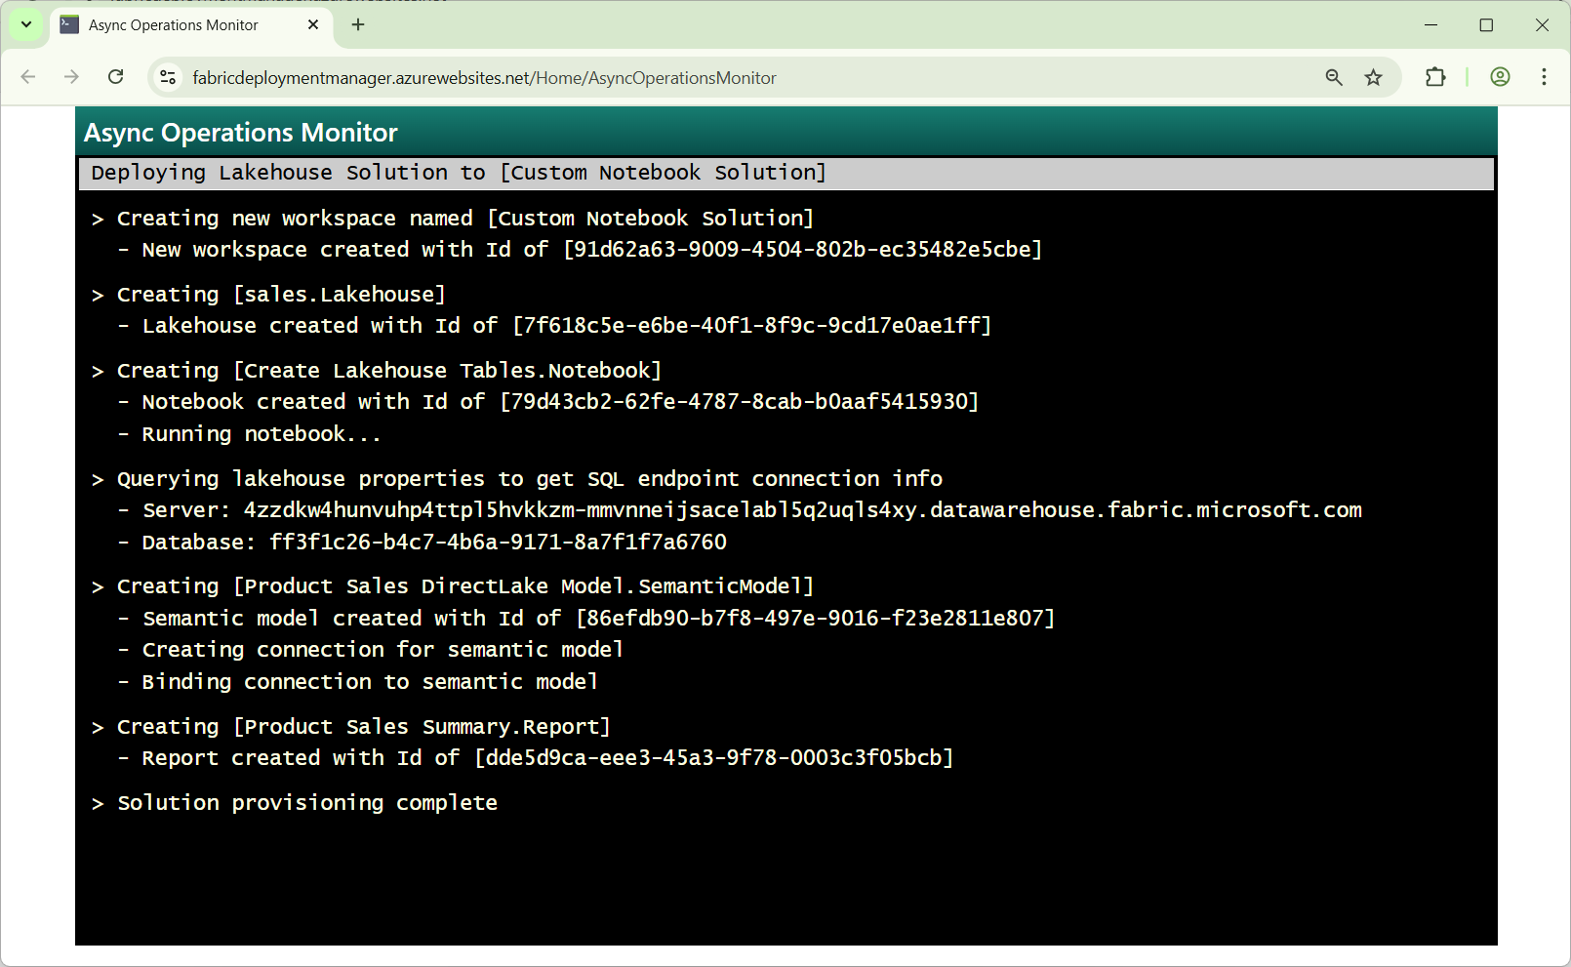
Developer Sample #2: FabricDeploymentManager
Sample Web application demonstrating how to implement solution deployment
Available at https://github.com/FabricDevCamp/FabricDeploymentManager
Created as ASP.NET Core Web application using the Fabric REST API .NET SDK
Uses built-in ASP.NET background service to process long-running asynchronous operations
Uses SignalR to send progress notifications to browser-based monitor

Slide 11
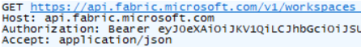
Fabric REST API Design and Architecture
Fabric REST API used to create and manage workspaces and workspace items
Fabric REST API designed to be accessible to any developer on any development platform
Built using principles of REST and open security standards (OAuth2 and Open ID Connect)
Public cloud endpoint accessible through base URL of https://api.fabric.microsoft.com/v1
Fabric REST API can be called as user or as service principal
Caller must first acquire access token for Fabric REST API from Entra Id
Caller must transmit access token in Authorization header for each API call
Your Application
Fabric REST APIs
access token
JSON Result
HTTP Response: 200 OK

Slide 12
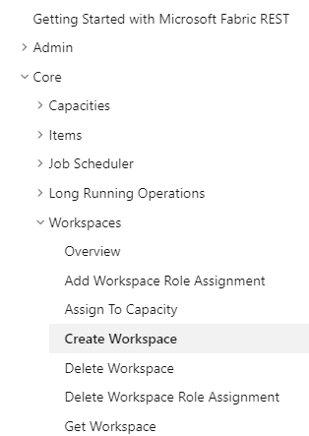
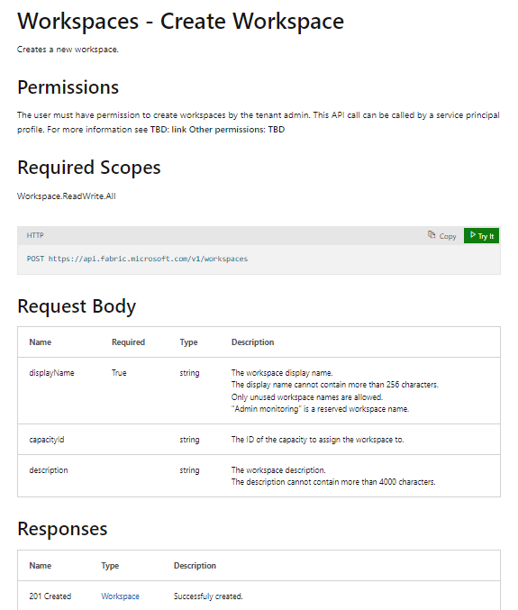
RTFM! = Read The Fabric Documentation
Fabric REST APIs documentation available online is essential developer resource
https://learn.microsoft.com/rest/api/fabric

Slide 13
Three Essential Fabric REST API Fundamentals
continuationToken
continuationToken
Fabric Rest API standardizes programming pattern for Long Running Operations (LRO)
Fabric REST APIs that support LRO can return either 201 Created or 202 Accepted
Call returns 201 Created when it successfully created the item in a synchronous operation
Call returns 202 Accepted when it successfully starts async operation to create the item
Developer must handle 202 Accepted response with callbacks to get operation state and result
Fabric REST APIs use paginated results to return large list-based sets of items
Presence of continuationToken and continuationUri in result tells developer there are more items
Developer must make additional calls to get data until final call returns without continuationToken
All Fabric REST API endpoints are throttled
Each Fabric REST API endpoint restricts each caller to a specific number of API calls per minute
Fabric REST API team currently in the process of documenting throttling limits for each endpoint
Fabric REST APIs return 429 Too Many Requests error when caller exceeds throttling limit
Developer should use Retry-After response header to delay execution until throttling window ends

Slide 14
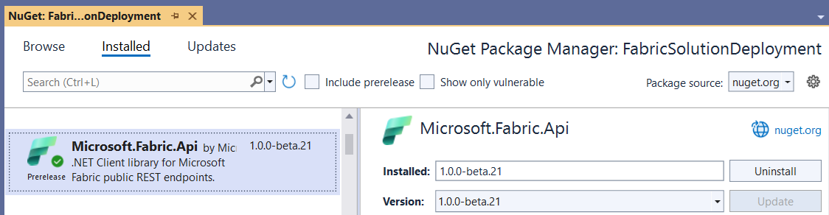
Fabric REST API .NET SDK
Fabric REST API provides .NET SDK to assist .NET developers
Distributed as a NuGet package named Microsoft.Fabric.Api
Hides tedious and low-level details associated with programming the Fabric REST APIs
Provides a significant productivity boost to developers
Why do we like programming with the Fabric REST API .NET SDK?
It handles long-running operations transparently behind the scenes
It handles paginated results and continuation tokens transparently behind the scenes
It handles throttling errors and Retry-After logic transparently behind the scenes

Slide 15
Morning Agenda
Creating and Updating Items using the Fabric REST APIs
Getting started with the Fabric REST APIs
Programming with item definitions
Creating and managing connections
Understanding challenges with CI/CD in Fabric solution deployment
Configuring datasource paths using Deployment Parameters
Automating solution deployment using a custom API-driven pipeline
Deploying and Updating Workspace Items from a Source Workspace
Exporting Workspace Items in Exported Solution Format
Deploying and Updating Solutions from Exported Solutions

Slide 16
Workspace Item Types
Fabric solutions designed and implemented in terms of workspace items
Developers can discover, create and manage workspace items inside scope of a workspace
Most (but not all) types of workspace items can be created and updated using item definitions
Blue workspace item types below are the ones we'll examine in this workshop
Creatable Workspace Item Types by Workload
Data Engineering
Power BI
Data Factory
Data Warehouse
Real-time Intelligence
Data Science
Lakehouse
SemanticModel
DataPipeline
Warehouse
Eventhouse
MLExperiment
Notebook
Report
Dataflow
MirroredWarehouse
Eventstream
MLModel
SparkJobDefinition
KQLDatabase
Environment
KQLQueryset
KQLDashbord

Slide 17






Workspaces with Sample Fabric Solution Scenarios
Custom Power BI Solution
Custom Notebook Solution
Custom Shortcut Solution
Custom Data Pipeline Solution
Semantic Model
Report
Lakehouse
Notebook
Semantic Model
Report
Lakehouse
Shortcut
Notebook
Notebook
Semantic Model
Report
Report
Report
Lakehouse
Notebook
Notebook
Data Pipeline
Semantic Model
Report
Report
Report

Slide 18
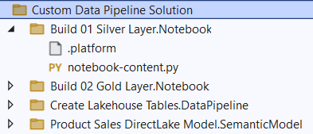
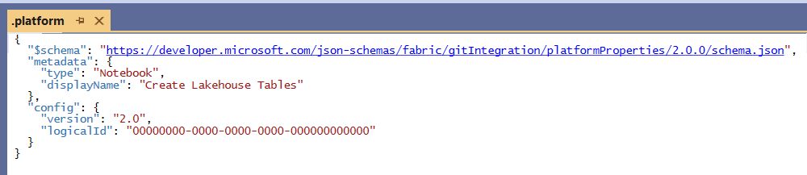
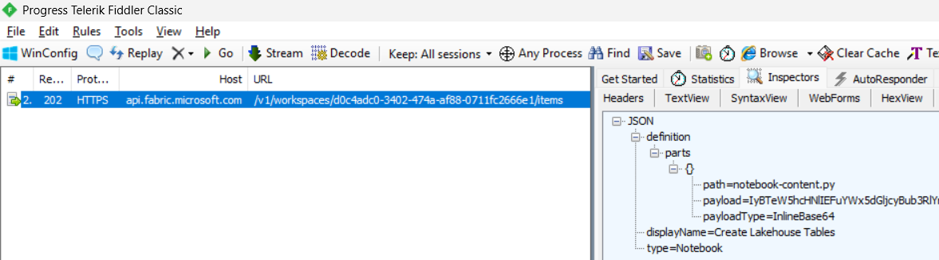
Item Definitions
Fabric DevOps strategy built on the concept of Item Definitions
Item definition is a set of files representing definition for a workspace item
Each type of workspace item has unique requirements for files in its item definition
Files in item definition known as item definition parts
Every item definition includes a platform file named .platform
Developer must format item definition parts with base64 encoding to transmit across network

Slide 19
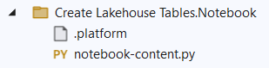
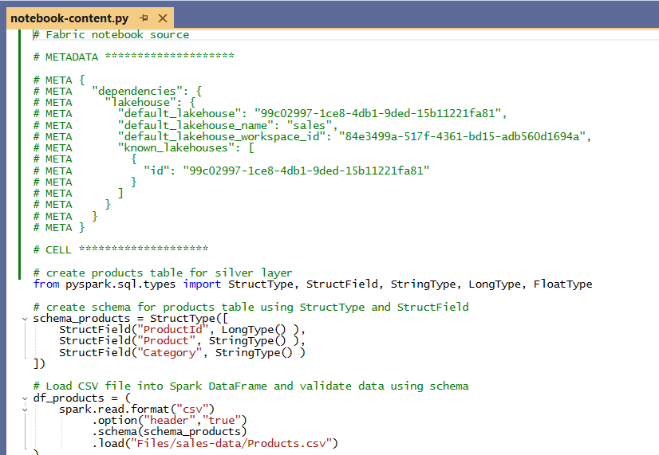
Notebook Item Definition Files
Item definition for notebook contained in single file named notebook-content.py
Default format for item definition based on is *.py files
Developers have option to work with JSON-based *.ipynb format
Top of file contains metadata section to link notebook to default lakehouse

Slide 20
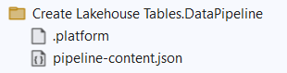
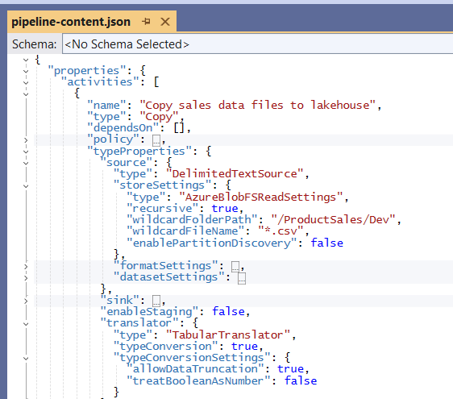
Data Pipeline Definition Files
Item definition for data pipeline contained in single file named pipeline-content.json
pipeline-content.json file contains reference for workspace Id and lakehouse Id
pipeline-content.json file contains notebook Ids and possibly other data pipeline Id
pipeline-content.json file contain connection Ids and partial data source paths

Slide 21
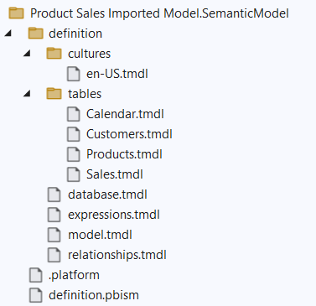
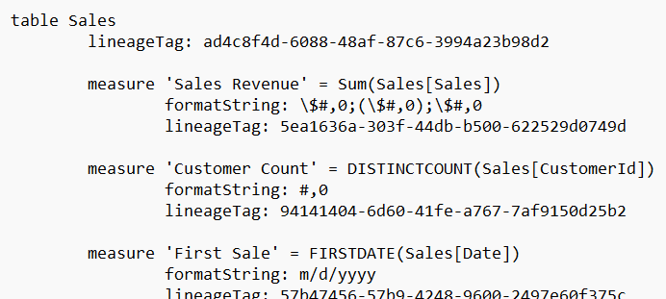
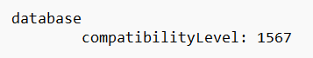
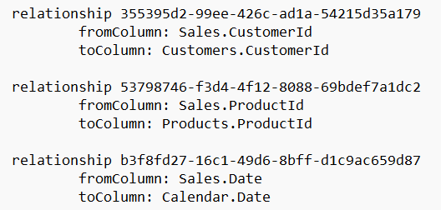
Semantic Model Item Definition Files
Item definition for semantic model supported in two different formats
Original format is TMSL which defines semantic model in single file named model.bim
New, preferred format is TMDL which uses YAML-like syntax using indentation
TMDL definition files are text-based and optimized for human readability and edit-ability

Slide 22
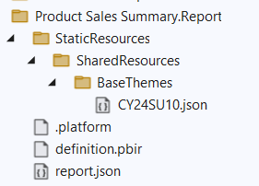
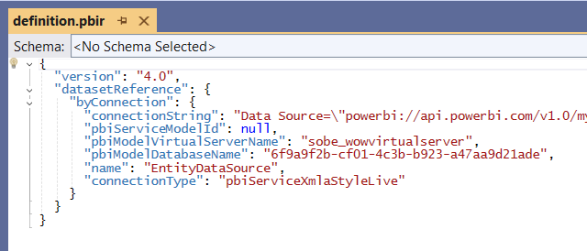
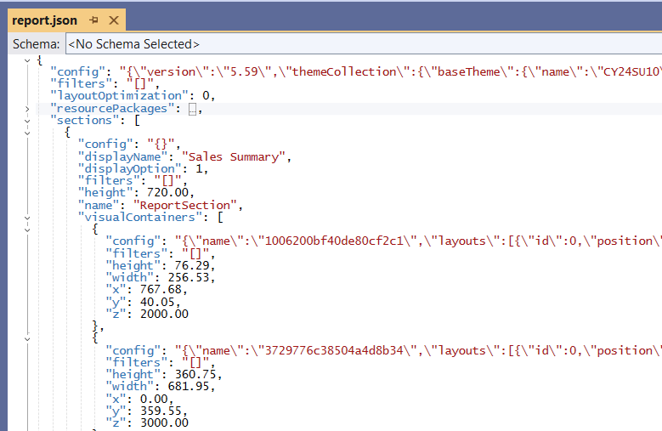
Report Item Definition Files
Item definition for reports supported in two different formats
Item definition files include definition.pbir which used to bind report to semantic model Id
Default format (PBIR-Legacy) based on report layout defined in single file named report.json
New format (PBIR) in public preview splits report definition into multiple files.
. and definition

Slide 23
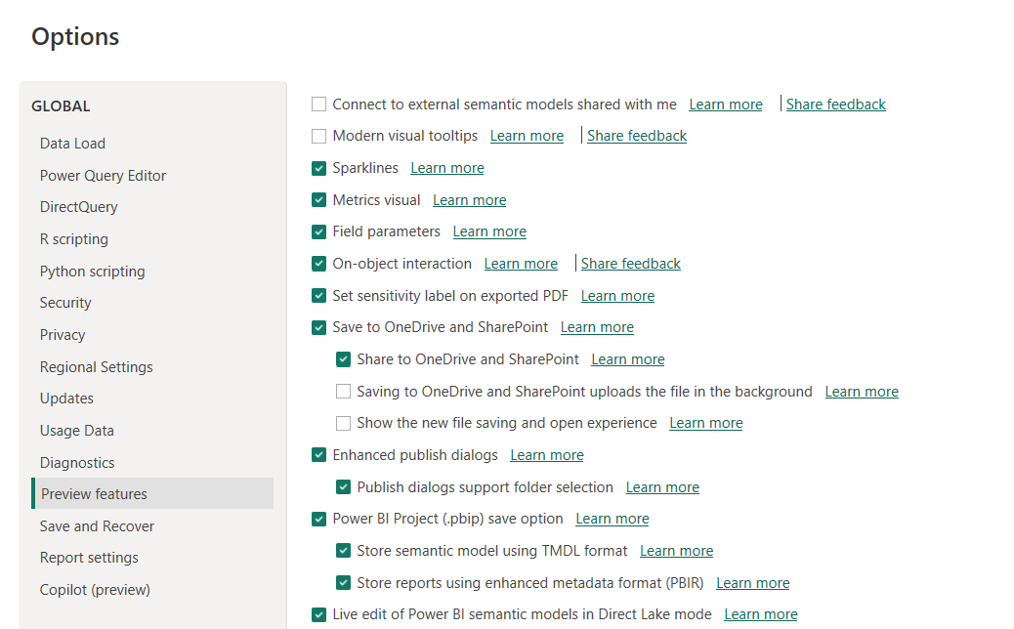
PBIP Projects in Power BI Desktop
Power BI Desktop supports Power BI Desktop Developer Mode (Preview)
Power BI Desktop has traditionally allowed saving projects in PBIX file format
Power BI Desktop preview feature allows saving projects in Power BI Project (PBIP) format

Slide 24
Programming with Fabric Item Definitions
Workspace items can be created and updated using item definitions
You can pass item definition when calling Create Item API
You can modify existing workspace item by calling Update Item Definition passing item definition
You can retrieve item definition for existing workspace item by calling Get Item Definition
Your Application
Fabric REST APIs
Item
Definition
POST - Create Item
Item
Definition
POST - Update Item Definition
Item
Definition
POST - Get Item Definition

Slide 25
Morning Agenda
Creating and Updating Items using the Fabric REST APIs
Getting started with the Fabric REST APIs
Programming with item definitions
Creating and managing connections
Understanding challenges with CI/CD in Fabric solution deployment
Configuring datasource paths using Deployment Parameters
Automating solution deployment using a custom API-driven pipeline
Deploying and Updating Workspace Items from a Source Workspace
Exporting Workspace Items in Exported Solution Format
Deploying and Updating Solutions from Exported Solutions

Slide 26
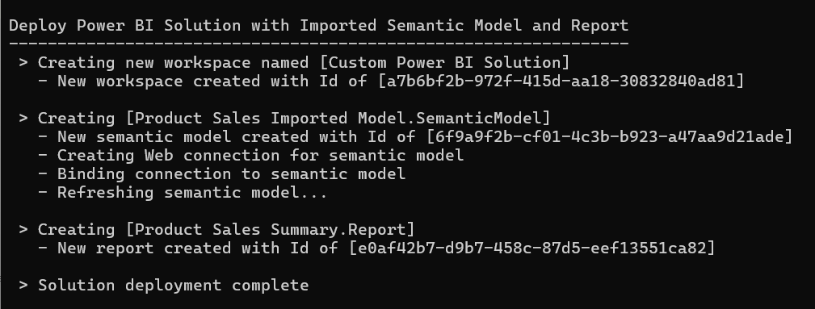
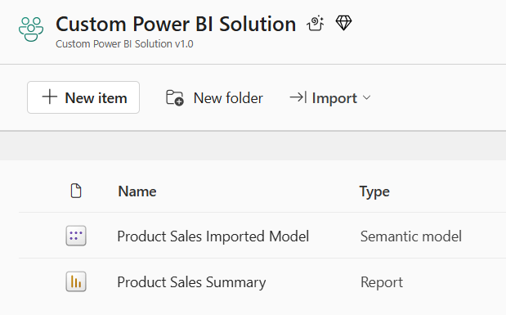
Deploy the Power BI Solution
Deployment steps with the Fabric REST API
Create workspace (includes assign to capacity & add role assignments)
Create imported semantic model using Create Item API
Create connection for semantic model using Create Connection API
Bind semantic model to connection using Datasets - Bind To Gateway In Group API
Refresh imported semantic model using Datasets - Refresh Dataset In Group API
Create report which is bound to semantic model using Create Item API

Slide 27



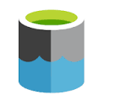
Connections and Connectors
Every connection in Fabric is based on a specific connector
Connector is a component that knows how to connect to and access specific type of datasource
Fabric uses the Web connector for connections to HTTP-based Web services
Fabric uses the AzureDataLakeStorage connector for connections to ADLS Gen2 storage container
Fabric currently supports over 200 different connectors
Fabric provides the List Supported Connection Types API for dynamic discovery
Workspace
Semantic Model
Connection
Web
OneLake Shortcut
Connection
AzureDataLakeStorage

Slide 28
Connection Connectivity Types
Sharable Cloud Connections (SCCs)
New style of connection which should be used whenever gateway is not involved
Connection can be configured with role assignments to provide access to security principals
This will be the only connection connectivity type discussed in this workshop
Personal Cloud Connections (PCCs)
Legacy connection type carried over from Power BI
On-prem Gateway Connections
Connections which are created using on-premises gateway datasource
Virtual Gateway Connections
Connections which are created using virtual gateway

Slide 29
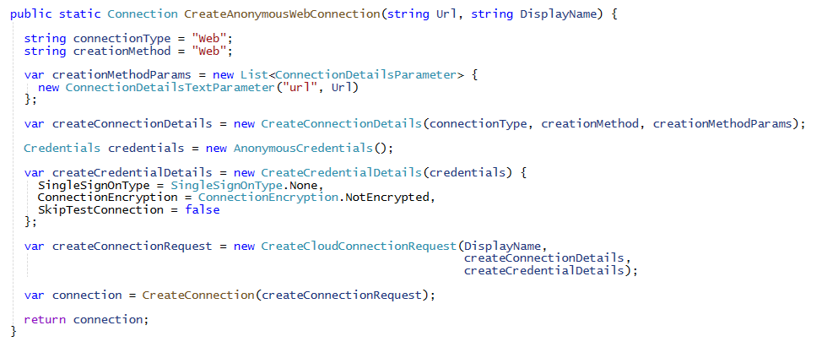
Creating Web Connection
Connections created using the Create Connections API
Use connectionType parameter to indicate which connector to use
Each connector has creationMethod which defines its list of connection details parameters
Each connection must be created with some type of credential (e.g. anonymous credentials)

Slide 30
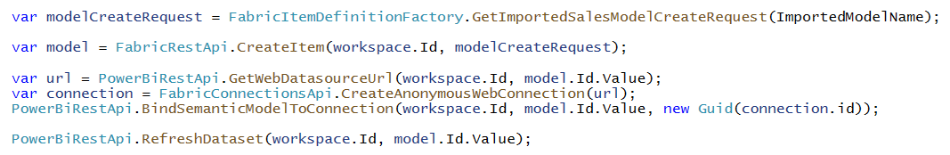
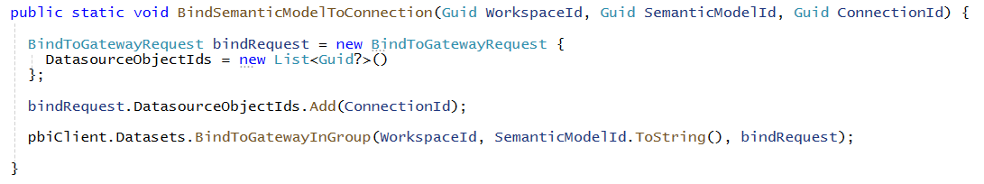
Preparing the Semantic Model after Creation
Imported semantic model needs to be refreshed after creating from item definition
Call to Create Item API creates semantic model but does not populate it with data
Currently, Power BI REST API required to bind connection and refresh semantic model
Developer binds semantic model to connection using Bind To Gateway In Group API

Slide 31
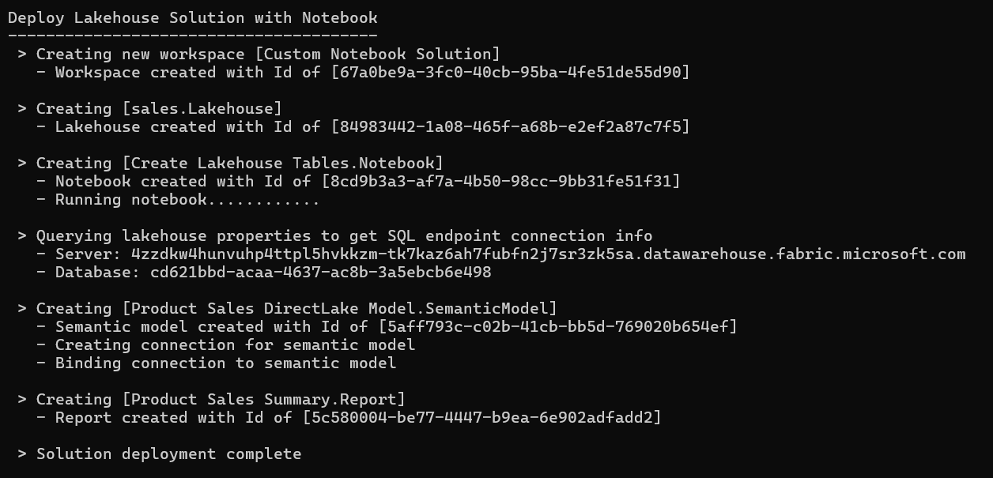
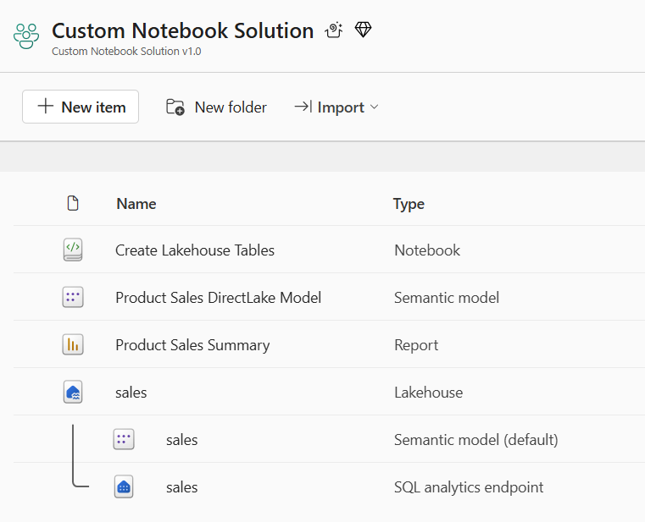
Deploy the Notebook Solution
Deployment steps with the Fabric REST API
Create workspace
Create lakehouse using Create Item API (lakehouse created without item definition)
Create notebook which is bound to lakehouse using Create Item API
Run notebook using Job Scheduler - Run On Demand Item Job API
Create DirectLake semantic model on top of lakehouse tables Create Item API
Create connection to lakehouse SQL endpoint and bind it to DirectLake semantic model
Create report which is bound to semantic model using Create Item API

Slide 32
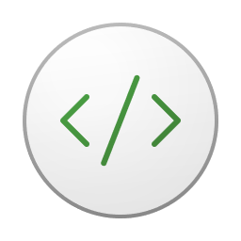

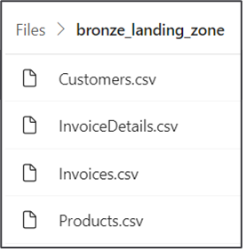
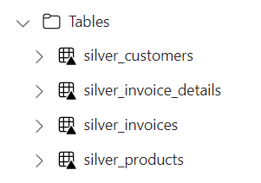
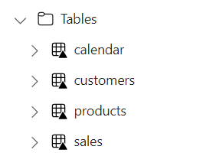


Using Spark Jobs to Create Lakehouse Tables
Fabric provides Spark runtime
Notebooks contain python code commonly used to ingest data files and build tables
Common practice to follow medallion architectures (bronze>silver>gold)
Fabric REST APIs provide Job Scheduler to run notebook and monitor its execution
Customer Tenant Workspace
Environment
Lakehouse
bronze layer
silver layer
gold layer
notebook
Spark job
Spark job
Spark job

Slide 33
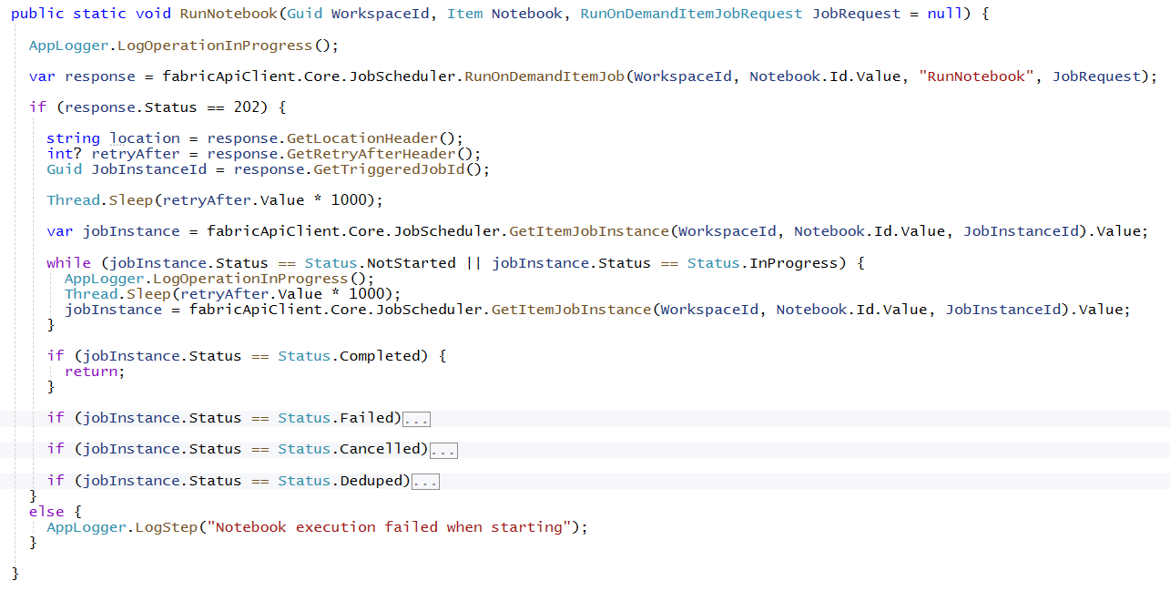
Example of Running Notebook using Job Scheduler

Slide 34

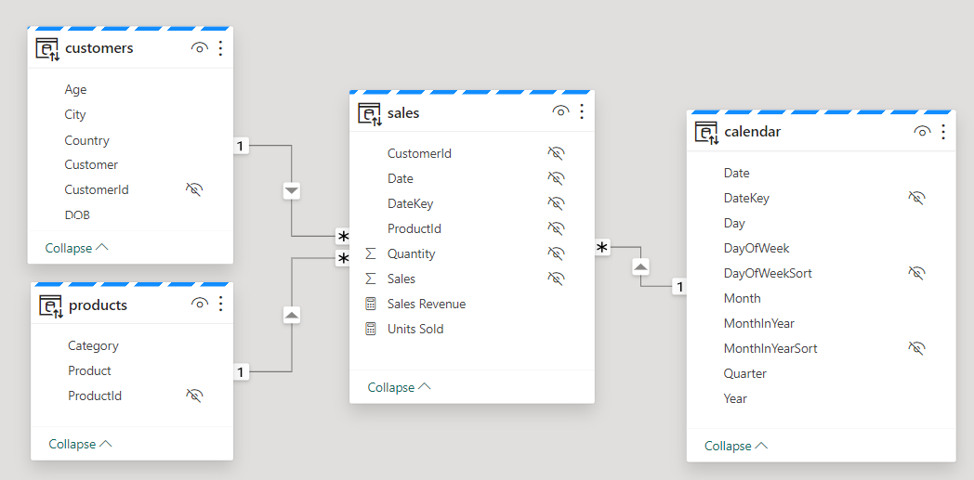
Creating DirectLake Semantic Models on Lakehouse Tables
Creating semantic model on lakehouse tables uses DirectLake mode
Semantic model created by passing model.bim to Create Item API
Semantic model allow you to define relationships, measures, hierarchies, etc.
CAVEAT: DirectLake semantic models do not support many import-mode features
Customer Tenant Workspace
Lakehouse
Semantic Model (aka Dataset)
SQL Endpoint

Slide 35
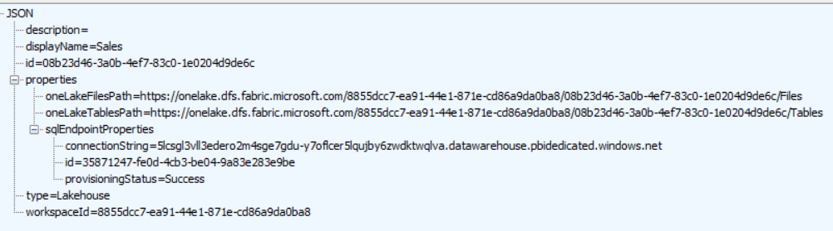
Lakehouse Properties
Retrieve lakehouse properties by executing GET request through /lakehouses endpoint
GET request with target URL of /workspaces/{WORKSPACE_ID}/lakehouses/{LAKEHOUSE_ID}
JSON response provides sqlEndpointProperties data required to create semantic model
SQL Connection Info

Slide 36
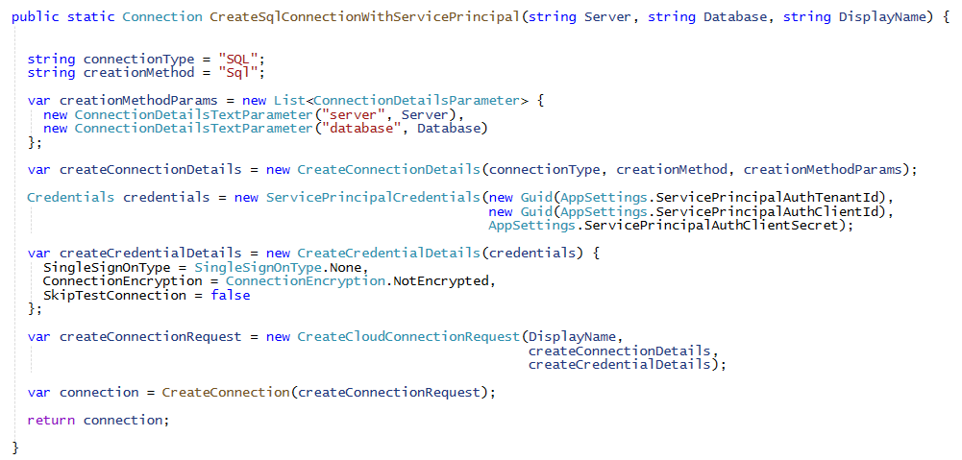
Creating Connections to Lakehouse SQL Endpoint
Use SQL connector to create semantic model connections to lakehouse SQL endpoint
Sql creation method requires two parameters named server and database
As of March 2025: the best approach is to uses service principal credentials
"cred-free" ability to create lakehouse connection using workspace identity is coming soon

Slide 37
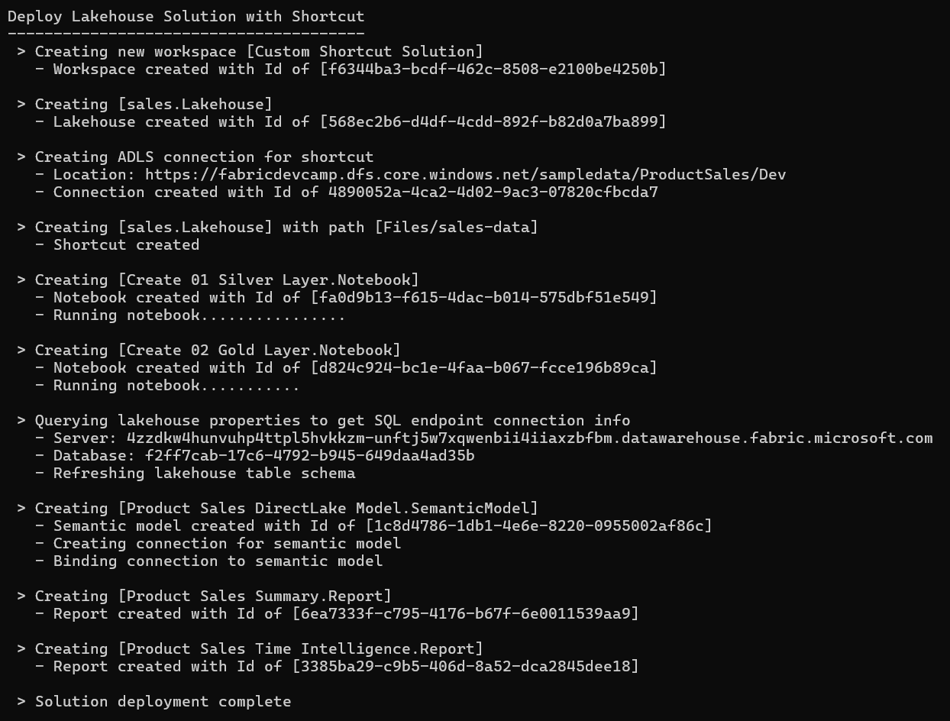
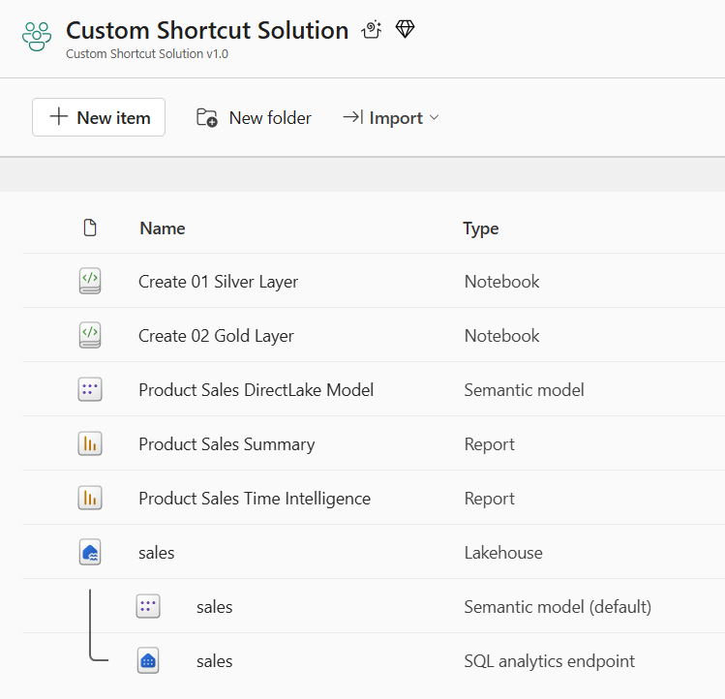
Deploy the Shortcut Solution
Deployment steps with the Fabric REST API
Create workspace
Create lakehouse using Create Item API
Create ADLS connection to Azure Data Lake Storage using Create Connection API0
Create shortcut in Files section lakehouse as bronze layer using Create Shortcut API
Create and run two notebook to build out silver layer and gold layer
Create DirectLake semantic model with connection just like previous sample
Create two reports which are bound to DirectLake semantic model using Create Item API

Slide 38
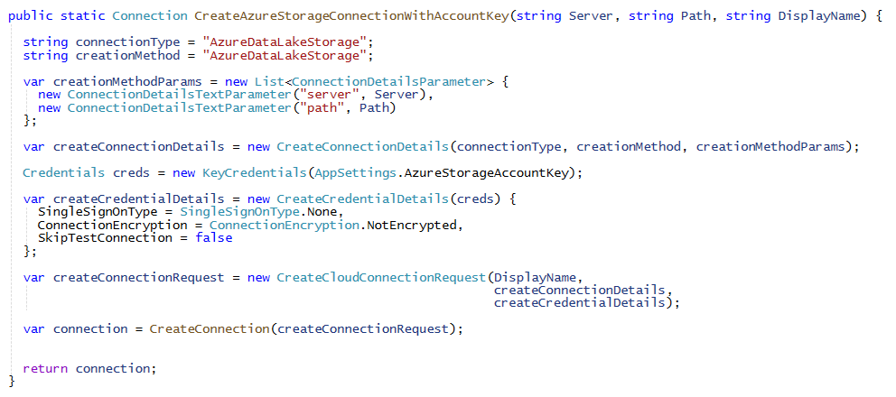
Creating Connections to Azure Data Lake Storage
Use AzureDataLakeStorge connector to create connections to ADLS container storage
AzureDataLakeStorge creation method requires two parameters named server and path
Supports key credentials, service principal credentials and workspace identity credentials

Slide 39
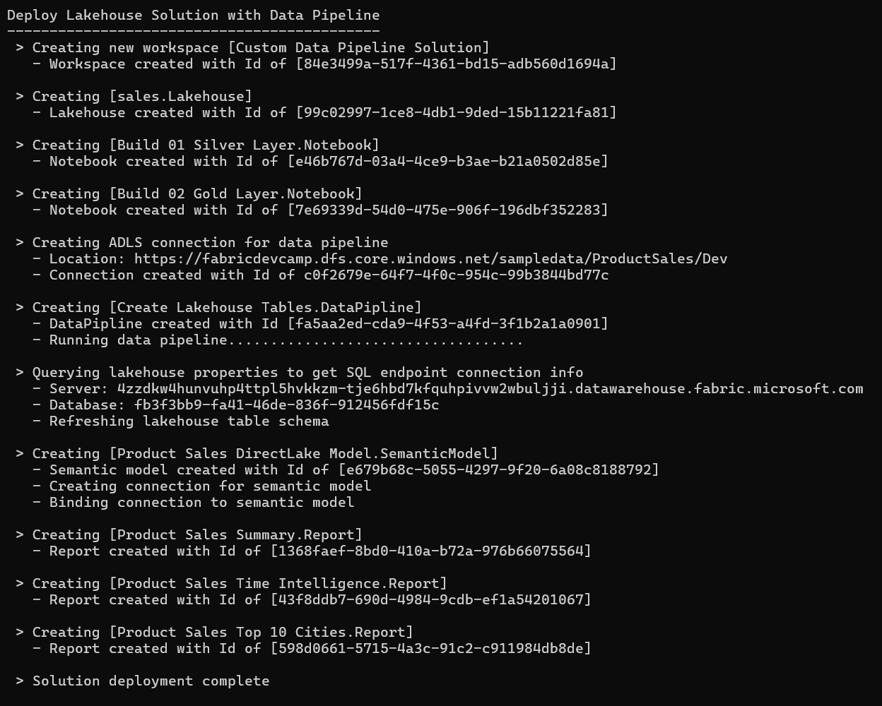
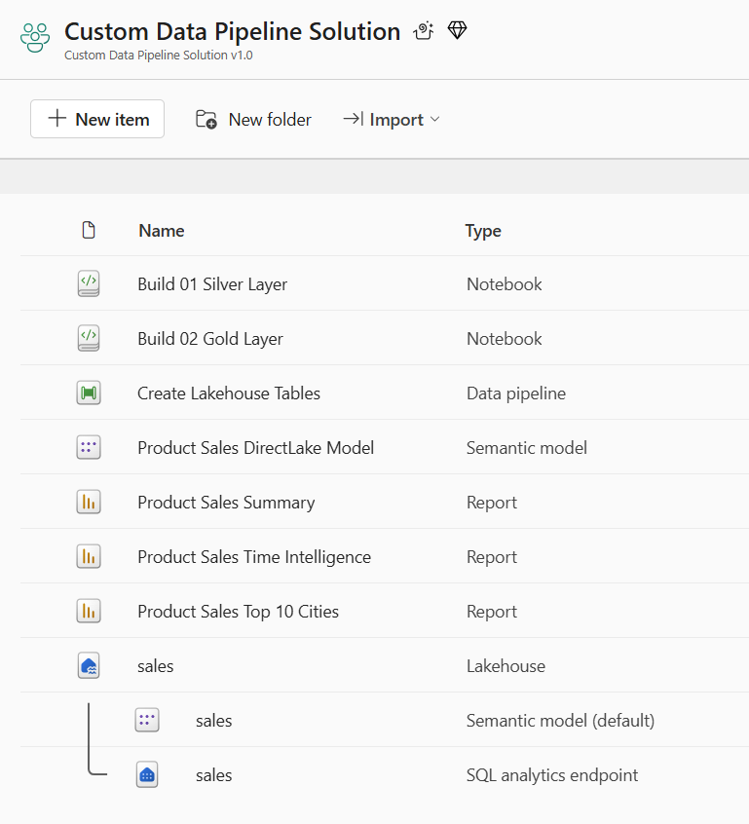
Deploy the Data Pipeline Solution
Deployment steps with the Fabric REST API
Create workspace
Create lakehouse using Create Item API
Create (but do not run) two notebooks using Create Item API to build out silver and gold layers
Create ADLS connection using Create Connection API
Create data pipeline configured to use ADLS connection using Create Item API
Run data pipeline to copy data files into lakehouse Files section and then run the two notebooks
Create DirectLake semantic model with connection just like previous sample
Create two reports which are bound to DirectLake semantic model using Create Item API

Slide 40
Morning Agenda
Creating and Updating Items using the Fabric REST APIs
Getting started with the Fabric REST APIs
Programming with item definitions
Creating and managing connections
Understanding challenges with CI/CD in Fabric solution deployment
Configuring datasource paths using Deployment Parameters
Automating solution deployment using a custom API-driven pipeline
Deploying and Updating Workspace Items from a Source Workspace
Exporting Workspace Items in Exported Solution Format
Deploying and Updating Solutions from Exported Solutions

Slide 41
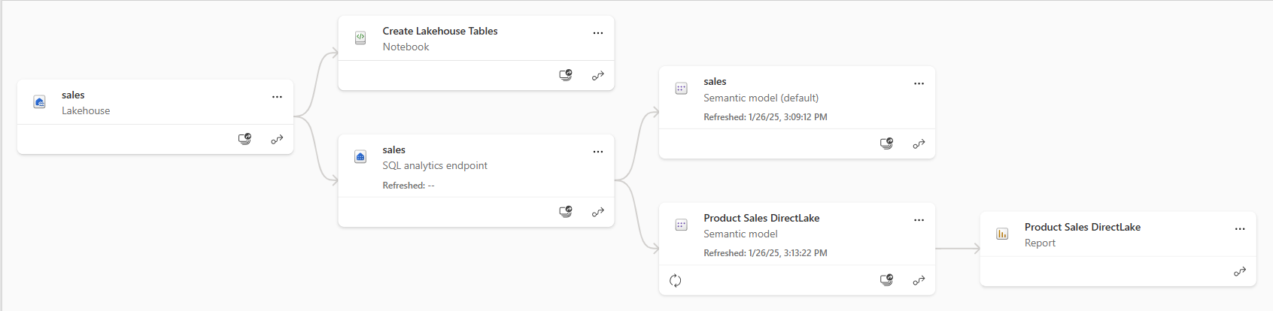
Understanding Workspace Item Dependencies
Many workspace items require dependencies on other workspace items
Notebook definition depends on workspace id and lakehouse id to reference its default lakehouse
Semantic depends on notebooks and/or data pipelines running to create table schema
DirectLake semantic model definition depends on connection string to SQL endpoint of lakehouse
Report definition depends on semantic model id
After deployment, solution should not have dependencies across workspaces
All dependencies should be self-contained in new workspace
Fabric solution deployment requires custom logic to update dependencies accordingly

Slide 42
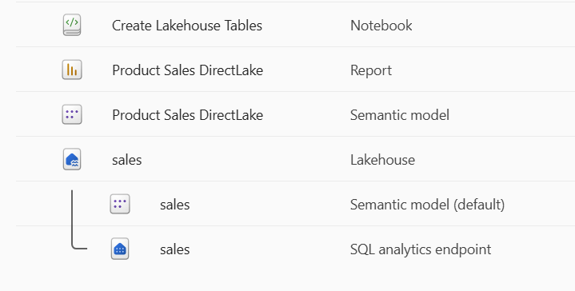
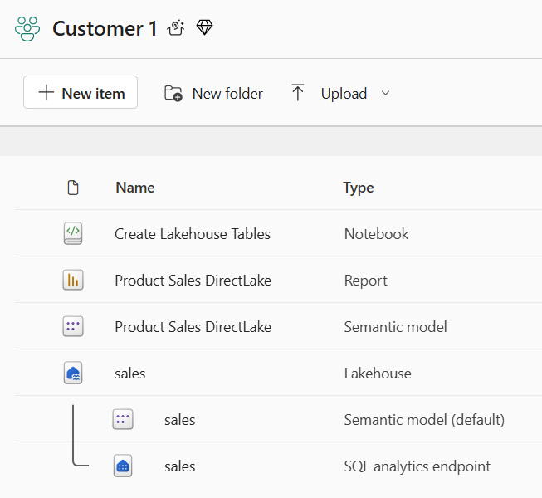
Creating Workspace Items with Dependencies
Deployment workflow must create workspace items with dependencies last
Notebook definition depends on lakehouse id for its default lakehouse
DirectLake semantic model definition depends on connection string to SQL endpoint of lakehouse
Report definition depends on semantic model id
Shallow copy of template workspace is not the result you want
Workspace for customer tenant should not have dependencies on source workspace
Source Workspace
Target Workspace

Slide 43
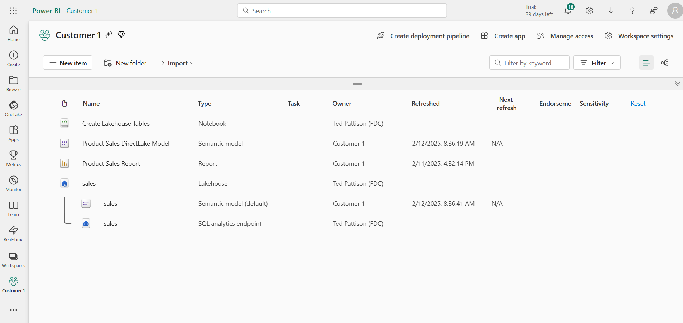

This deployment result IS NOT what you want
Checking for intra-workspace dependencies
Navigate to Lineage view to see item dependencies
Look for items that have dependencies on items in other workspaces

Slide 44
Challenge of Managing Connections at Workspace Scope
Unlike workspace items, connection items are scoped at level of Entra Id tenant
Connections can be (but shouldn't be) shared across workspaces
Fabric currently lacks API support for workspace-level management of connections
No support in Fabric GIT integration to track, backup, restore or recreate connections
Developer must leverage innovative approach for managing connections at scope of workspace
Platform Item Types
Capacity
Workspace
Connection
Gateway
Workspace Item Types by Workload
Power BI
Data Engineering
Data Warehouse
Data Factory
Real-time Intelligence
Data Science
SemanticModel
Lakehouse
Warehouse
DataPipeline
Eventhouse
MLExperiment
Report
Notebook
MirroredWarehouse
Dataflow
Eventstream
MLModel
SparkJobDefinition
KQLDatabase
Environment
KQLQueryset
KQLDashbord

Slide 45

Using a Naing Convention for Managing Connections
Using connection naming convention allows for management at workspace scope
Connection name contains Workspace Id
Connection name also indicates connection type (e.g. Lakehouse(sales) vs ADLS vs Web)
Benefits to connection naming convention
It allows for cascading connection deletes when deleting workspace
Allows for discovery of connection when inspecting source workspace
Enables recreating connections for lakehouse shortcuts and data pipelines during deployment
Workspace[WORKSPACE_ID]-Lakehouse[sales]
Workspace[WORKSPACE_ID]-ADLS
Workspace[WORKSPACE_ID]-Web

Slide 46
Morning Agenda
Creating and Updating Items using the Fabric REST APIs
Getting started with the Fabric REST APIs
Programming with item definitions
Creating and managing connections
Understanding challenges with CI/CD in Fabric solution deployment
Configuring datasource paths using Deployment Parameters
Automating solution deployment using a custom API-driven pipeline
Deploying and Updating Workspace Items from a Source Workspace
Exporting Workspace Items in Exported Solution Format
Deploying and Updating Solutions from Exported Solutions

Slide 47

Parameterizing Customer Data and Datasource Paths
Solution design required to parameterize customer datasource paths
Deployment must implement parameterization pattern to integrate unique customer data
Essential Question - Where do datasource paths live inside item definition files?
Adventure Works Datasources
Customer 1
Workspace
ADLS Gen2
Storage Container
Azure
SQL Database
Fabric Solution Template
Solution Deployment Logic
Contoso Datasources
Customer 2
Workspace
ADLS Gen2
Storage Container
Azure
SQL Database
Fabrikam Datasources
Customer 3
Workspace
ADLS Gen2
Storage Container
Azure
SQL Database

Slide 48

Datasource Path in a Notebook
Notebook definition can contain datasource path
Developers can add URLs directly in their python code

Slide 49



Data Source Path in a Semantic Model
The expressions.tmdl file is typical place to find datasource URL for semantic model
Example of imported model with datasource path for Web connection
Example of DirectLake model with datasource referencing lakehouse SQL endpoint

Slide 50

Datasource Paths and Connection Id in a Data Pipeline
Data Pipeline definition holds ADLS container path and name and connection Id

Slide 51

Workspace Id and Notebook Ids in Data Pipeline
Data Pipeline definition holds workspace Id, lakehouse Id and notebook Id

Slide 52


Deployment Parameters
FabricSolutionDeployment project introduces concept of Deployment Parameters
Deployment parameters contain unique values to be used in deployment of customer tenant
Developer samples use DeploymentPlan class to implement parameterization pattern
Deployment parameters modeled as Dictionary<string, string> property named Parameters

Slide 53



SampleCustomerData class
Deployment and update methods accept DeploymentPlan instance as parameter
SampleCustomerData class provides sample customers as static properties
Deployment parameters added to configure data source paths for Web and ADLS connections
Sample customer data makes it easy to test multitenant deployments

Slide 54

Deployment Parameters
DeploymentPlan instance with Parameters collection passed to deployment operations
Deployment operations integrate deployment parameters into provisioning process
Deployment parameters loaded at start of deployment and update operations
Deployment and update logic looks for presence of specific named parameters
When found, deployment parameters trigger conditional logic to modify target datasource paths

Slide 55



Deployment Parameters in Action
Presence of specific deployment parameters indicate datasource paths which require substitution
UpdateItemDefinitionPart method used to update file in item definition using substitution
SearchAndReplaceInPayload method deals with base64 encoding and performs substitution

Slide 56



Sample Product Sales Data Used in Developer Samples
Developer samples use ProductSales sample data
Sample data used to simulate data for different customer in multitenant environment
Sample data based on common table schema (Products, Invoices, InvoiceDetails & Customers)

Slide 57



Gratuitous Screenshots: Adventure Works Sample Data

Slide 58



Gratuitous Screenshots: Contoso Sample Data

Slide 59



Gratuitous Screenshots: Fabrikam Sample Data

Slide 60



Gratuitous Screenshots: Northwind Sample Data

Slide 61



Gratuitous Screenshots: Wingtip Toys Sample Data

Slide 62



Gratuitous Screenshots: Seamark Farms Sample Data

Slide 63
Morning Agenda
Creating and Updating Items using the Fabric REST APIs
Getting started with the Fabric REST APIs
Programming with item definitions
Creating and managing connections
Understanding challenges with CI/CD in Fabric solution deployment
Configuring datasource paths using Deployment Parameters
Automating solution deployment using a custom API-driven pipeline
Deploying and Updating Workspace Items from a Source Workspace
Exporting Workspace Items in Exported Solution Format
Deploying and Updating Solutions from Exported Solutions

Slide 64
Developing a Custom API-driven Pipeline
Deploy operation creates new target workspace and clones source workspace items
Deploy always creates new target workspace and builds its contents from scratch
Deploy leverages Fabric REST APIs to create workspaces, connections and workspace items
After solution has been deployed, Update operation updates target workspace items
Source workspace items that already exist in target workspace are updated
Source workspace items that do not already exist in target workspace are created
Target workspace items not in source workspace (aka orphaned items) can optionally be deleted
Source Workspace
Target Workspace
Deploy
Items
Source Workspace
Target Workspace
Update
Items

Slide 65


Options for API-driven Solution Deployment
Option 1: Deploy from live source workspace
Option 2: Export workspace to local solution folder and then deploy from local solution folder
Option 3: Export workspace to ADO repository branch and then deploy from that branch
Source Workspace
Deploy
from
Workspace
Target
Workspace
Source Workspace
Exported Solution Folder
Export from
Workspace to
File System
Deploy
from
Export
Target
Workspace
Source Workspace
Export from
Workspace to
ADO Branch
Deploy
from
ADO Export
Target
Workspace

Slide 66
Assumption in Developer Sample
Upgrade only supported in workspaces where same solution has been deployed
Solution name tracked in description of tenant workspaces
Workspace items: lakehouse, notebook, data pipeline, semantic model and report
Adding additional items requires extending logic in developer samples
Connections are aways created with naming convention
Solution can have one Web connection using anonymous credentials
Solution can have one ADLS connection with account key credentials
Solution can have as many lakehouse SQL endpoint connections are necessary
Notebooks and data pipelines with "Create" in their name are run after they're created
Notebooks and data pipelines designed to populate lakehouse tables during deployment process
Notebooks and data pipelines abstract away data acquisition logic from deployment logic

Slide 67

Deploy from Workspace
Deploy from Workspace uses source workspace as solution template
Pipeline recreates connections discovered in source workspace
Pipeline calls Get Item Definition on source workspace items
Pipeline modifies item definitions from source to redirect dependencies
Pipeline calls Create Item to create new item in solution workspace
Deploy
from
Workspace

Slide 68


Deploy from Workspace Demo
Select Source Workspace and Customer Name

Slide 69

Tracking Workspace Item Dependencies in Dictionaries
walkthrough of DeployFromWorkspace method
Method creates large set of Dictionary<string, string> instances to track dependency substitutions
Method calls RecreateWorkspaceConnections

Slide 70


Recreating Source Workspace Connections
RecreateWorkspaceConnections calls GetWorkspaceConnections on source workspace
Conditional logic used to create Web and AzureDataLakeStorage connections

Slide 71

Recreating Web Connections
When Web connection is found in source workspace…
Logic looks for webDatasourcePathParameter deployment parameter to change web source URL
Logic creates Web connection using Create Connections API
Logic adds substitution pair for source connection Id and new connection Id
Logic adds substitution pair for source datasource path and new datasource path

Slide 72

Recreating ADLS Connections
When AzureLakeDataStorage connection is found in source workspace…
Logic looks for set of three adls* deployment parameter to change web source URL
Logic creates AzureLakeDataStorage connection using Create Connections API
Logic adds substitution pairs for connection Ids and datasource paths

Slide 73

Sequence of Workspace Item Processing
(1) Lakehouses > (2) Notebooks > (3) Data Pipelines > (4) Semantic Models > (5) Reports

Slide 74
Deployment by Cloning Items from Source Workspace
Workspace items can be cloned using item definitions
Retrieve item definition from source workspace by calling Get Item Definition
Manipulate content of item definition part files such as substitute source Ids for target Ids
Pass manipulated item definition to Create Item API to create new item
Pass manipulated item definition to Update Item Definition API to update existing item
Source
Workspace
Your Application
Target
Workspace
Item
Definition
Item
Definition
Source
Definition
Create Item
Get Item Definition
update
Item
definition
Item
Definition
Updated
Definition
Update Item Definition

Slide 75


Performing Id Substitution with notebook-content.py
Notebook dependencies must be updated to point to newly created lakehouse
Source workspace Id must be replaced with target workspace id
Source lakehouse Id must be replaced with target workspace id
Substitution schema works even when there are multiple lakehouses
Your Application
Source
Definition
update
Item
definition
Search and Replace Operation
Output
Updated
Definition

Slide 76


Update from Workspace
Update from Workspace uses source workspace as solution template
Pipeline inspects connections in source workspace and target workspace to create redirects
Pipeline calls Get Item Definition and modifies item definitions
Pipeline calls Update Item Definition to update existing item in target workspace
Pipeline calls Create Item to create items which do not exist in target workspace
Pipeline can optionally delete orphaned items

Slide 77
Morning Agenda
Creating and Updating Items using the Fabric REST APIs
Getting started with the Fabric REST APIs
Programming with item definitions
Creating and managing connections
Understanding challenges with CI/CD in Fabric solution deployment
Configuring datasource paths using Deployment Parameters
Automating solution deployment using a custom API-driven pipeline
Deploying and Updating Workspace Items from a Source Workspace
Exporting Workspace Items in Exported Solution Format
Deploying and Updating Solutions from Exported Solutions

Slide 78
Export from Workspace
Developer uses Fabric REST APIs to build set of files used for export/import operations
Set of exported files can be saved to folder in local file system
Set of exported files can be saved in branch in GIT-enabled source control system
Sequence is steps in ExportFromWorkspace
Call Get Item Definition for supported items and save files to target storage
Create folder and .platform file for each lakehouse
Generate depoly.config.json file
Source Workspace
Packaged Solution Folder
Export
from
Workspace
Deploy
from
Export
Target
Workspace
Source Workspace
Export
from
Workspace
Deploy
from
Export
Target
Workspace

Slide 79



Export from Workspace
dd
ddd

Slide 80

Retrieving and Saving Item Definitions
ExportFromWorkspace leverages Fabric REST API to generate item definitions
Call Get Items to discover all items in source workspace
Call Get Item Definition on supported workspace item types
Save each result from Get Item Definition in its own folder with standard item naming scheme

Slide 81



Adding Export Metadata for Lakehouse
Lakehouse requires special attention because it does not support Get Item Definition
Custom export logic creates item definition folder and .platform file for each lakehouse
.platform file generated using standard Fabric schema

Slide 82



GenerateDeployConfigFile
GenerateDeployConfigFile method used to generate deploy.config.json
deploy.config.json file generated from workspace and connection metadata

Slide 83




deploy.config.json
Custom export format requires generating metadata file named deploy.config.json
deploy.config.json file contains workspace item Ids required for substitution
deploy.config.json file contains lakehouse metadata for SQL endpoint an shortcuts
deploy.config.json file contains metadata on workspace connections

Slide 84


gggg
jjj

Slide 85



dd
dddd
dddd

Slide 86
Morning Agenda
Creating and Updating Items using the Fabric REST APIs
Getting started with the Fabric REST APIs
Programming with item definitions
Creating and managing connections
Understanding challenges with CI/CD in Fabric solution deployment
Configuring datasource paths using Deployment Parameters
Automating solution deployment using a custom API-driven pipeline
Deploying and Updating Workspace Items from a Source Workspace
Exporting Workspace Items in Exported Solution Format
Deploying and Updating Solutions from Exported Solutions

Slide 87

Deploy From Export
Deploy from Export makes it possible to deploy directly from exported solution folder
Files in export folder provide everything need for DEPLOY and UPDATE operations
Deploy from Export removes live workspace dependency from for DEPLOY and UPDATE operations
Deploy from Export eases DEPLOY and UPDATE across environment and Entra Id tenant boundaries
Customer 1 Workspace
Deploy
from
Export
Solution Export
Dev Workspace
Customer 2 Workspace
Export
from Workspace
Deploy
from
Export
Deploy
from
Export
Customer N Workspace

Slide 88



Deploy from Export
xxx\\
xxxx

Slide 89


Update from Export (Full Update)
xxx
xxxx

Slide 90


Update from Export (Reports Only)
sssss
ssssss

Slide 91

Update All Tenants from Export

Slide 92

Creating an ADO project for a Custom Solution

Slide 93


Slide 94




Export from Workspace to Azure Dev Ops
sssss
sss

Slide 95




Deploy from ADO Export
ffff
ffff

Slide 96


Slide 97



xxx
vvvv

Slide 98


Slide 99

Deploy From ADO Export
Deploy from ADO Export makes it possible to deploy directly from GIT branch
Deploy from ADO Export allows deploying to Test workspace for verification and approval
Developers can create pull request to promote exported branch to release branches
Deploy from ADO Export can be used to deploy from releases branches to customer tenants
Test Workspace
Customer 1 Workspace
Deploy
from Export
Deploy
or
Update
Dev Workspace
Customer 2 Workspace
Export
from Workspace
Deploy
or
Update
Deploy
or
Update
Customer N Workspace

Slide 100
Deploy From Export Together with Fabric GIT Integration
When combing API-driven pipeline with Fabric GIT integration support
Use GIT integration and feature workspace to develop and introduce new workspace items
GIT integration used to add changes to Dev workspace
Deployment from Dev workspace implemented using custom API-driven pipeline
Customer 1 Workspace
Deploy
or
Update
Dev Workspace
Deploy
or
Update
Customer 2 Workspace
Export
from Workspace
Deploy
or
Update
feature01 Branch
GIT Integrated Serialization
Customer N Workspace
Feature01 Workspace
Deploy
from Export
main Branch
pull requests
Test Workspace
feature01 Branch
Feature01 Workspace
pull requests

Slide 101
Agenda
Creating and Updating Items using the Fabric REST APIs
Automating Deployment using a Custom API-driven Pipeline
CI/CD – Development workflow with GIT
CI/CD – Deployment Options using GIT & Deployment Pipeline

Slide 102

What is DevOps?

Slide 103




Native CI/CD Platform Features
Built-in git integration
Deployment pipelines
Fabric REST APIs
Variable Library
GA feature
Public preview
103
Microsoft Fabric
Notes:
Talk about CI and CD options that is availaible

Slide 104

Continuous Integration – GIT Integration Concepts
Avaliable as a Workspace Setting
Supports multiple GIT Providers
Workspace connected to single branch
Sync workspace to GIT and vice-versa
Rich UX for No-Code experience
Multiple options for Branching
Items stored in Native format
Automation with Fabric GIT APIs
Supported Git Providers
Supported Workspace Items
104
Microsoft Fabric
Notes:
Talk about selective commit , changes as part of roadmap
Mention irreversible nature of workspace update from GIT

Slide 105



Continuous Integration – Managing Branches
Branch out to new workspace –
Create a new isolated work environment (workspace & branch) in a few clicks.
After clicking ‘Create’:
New workspace is created and assigned to a capacity
New branch is created, based on existing branch
New branch and workspace are connected
Branch content is synced into the workspace
Developer lands in new workspace, reducing ‘time-to-code’.
Contextual Navigation & Branches Tab
Find other branches and navigate to their respective workspaces.
Contextual list of the same ‘branch workspaces’.
105
Microsoft Fabric
Notes:
Talk about selective commit , changes as part of roadmap
Mention irreversible nature of workspace update from GIT

Slide 106



Continuous Integration – Managing Branches
Switch Branch
Enables developers to switch & sync existing workspace to a different GIT branch
Prompts in case uncommitted items
Ability to create new Devops branch from existing branch
Checkout Branch
Creates new branch & connect workspace to it
Uploads all the supported items to new branch
Useful to resolve Conflict
106
Microsoft Fabric
Notes:
Talk about selective commit , changes as part of roadmap
Mention irreversible nature of workspace update from GIT

Slide 107
Continuous Integration – GIT Integration Concepts
DEMO
GIT Interactions
GIT File structure & .platform file
Branch Out functionality
Switch & Checkout functionality
Update & Publish
Restoring to previous version
Notes:
DEMO
GIT Interactions
GIT File structure & .platform file
Branch Out functionality
Switch & Checkout functionality
Update & Publish
Restoring to previous version

Slide 108









Continuous Integration : Development Workflow
Setting up Dev Workspace: The project lead sets up a Main workspace' and connects it to the "main branch“ if not already done
PR & Merge: Once a developer completes work & commit on a feature branch, they initiate a pull request to merge it into the main branch
Build Pipeline: Upon the completion of a PR, a DevOps pipeline triggered to sync updated items from GIT->Workspace & manage dependencies
Setting up Feature Workspaces: Developers creates feature workspaces mapped to feature branches using one of available options ( UX or code)
Switch Branch: It is recommended that developers do not delete their workspaces after completing a feature branch pull request
1
2
Web UI
2
Feature Workspaces
1
Main Dev Workspace
Sync
Update
4
3
Pull
Branch
IDE
Push
Merge
4
Main
branch
Feature
branch
3

Slide 109
Demo – Multiple Developers Working In A Project
DEMO
Creation & Initialization of Feature Workspace
Data Seeding in Feature workspace
PR Management
ADO Pipeline to Sync

Slide 110
Demo – Multiple Developers Working In A Project
Person | Role
Jessy | Team Lead
Alex | Data Integration Developer
Tom | Data Engineering Developer
Jessy sets up the development workspace connected to development branch
Team creates feature workspaces by leveraging “Branch out” option from the Dev workspace, connecting to their respective feature branches
Team works in their feature workspaces and commits changes to feature branches
Team raises PR which Jessy reviews & merge to Dev branch
Build pipeline synchronizes changed items from Dev branch to Dev workspaces
110
Notes:
Recommendation:
Each developer works on their own feature workspace.
Commit changes to the feature branch isolated from the main branch and main workspace.
Ensure changes do not interfere with others' work.
Request a Pull Request to merge the feature branch into the main branch, initiating a code review process.
Ensure approval before integration.
The Azure pipeline uses the Git- Update From Git APIs to sync the main branch and the main workspace.

Slide 111
Agenda
Creating and Updating Items using the Fabric REST APIs
Automating Deployment using a Custom API-driven Pipeline
CI/CD – Development workflow with GIT
CI/CD – Deployment Options using GIT & Deployment Pipeline

Slide 112
Fabric Deployment Options
Fabric Deployment Pipeline
No-code
Deploys from Dev workspace
Fabric GIT Integration
GIT as source of truth
Pro-Dev
Fabric Rest APIs
Code-first solution
Greater flexibility
Low Code
Start
Yes
Deployment Pipelines
No
Customer Prefers ADO / Git Hub
Yes
Git Integration
No
Custom
REST APIs
112
Microsoft Fabric

Slide 113

Continuous Delivery - Fabric Deployment Pipeline
Native & No-Code deployment
Supports 2-10 stages
Apply deployment rules on configuration
Maintains relationship & order of Items
Compare changes on code-level
Supports REST APIs for automation
113
Microsoft Fabric

Slide 114
Continuous Integration – Fabric Deployment Pipeline
DEMO
114
Microsoft Fabric

Slide 115
Continuous Delivery – Fabric GIT APIs
Connect | Connect a specific workspace to a git repository and branch.
Disconnect | Disconnect a specific workspace from the Git repository and branch it is connected to.
Initialize Connection | Initialize a connection for a workspace that is connected to Git.
Get Connection | Returns git connection details for the specified workspace.
Commit To Git | Commits the changes made in the workspace to the connected remote branch.
Get Status | Returns the Git status of items in the workspace, that can be committed to Git.
Update From Git | Updates the workspace with commits pushed to the connected branch. ConflictResolutionPolicy helps to determine which way to sync: GIT->Workspace or Workspace->GIT
115
Microsoft Fabric
Notes:
Talk about selective commit , changes as part of roadmap
Mention irreversible nature of workspace update from GIT

Slide 116
Continuous Delivery - Fabric Item APIs
Automated operations on behalf of Fabric users.
Supported scenarios:
Item management (CRUD)
Item definition
Workspace & Capacity Management
Workspace access management
Execute item jobs
116
Microsoft Fabric

Slide 117
Continuous Delivery - Decision Tree
Continuous Delivery
Fabric Deployment Pipeline
Intuitive UX Driven & No Code solution
Inbuilt Permission & deployment history
REST API for DevOps tools
Fabric GIT
GIT to be source of truth
Pro-Dev
REST API for automation
UX based Interaction
Fabric Items APIs
Flexible for complex scenarios
Supports multiple Code repositories & DevOps tool
Robust REST API support
Multi-Tenant support
UX Driven?
Yes
Fabric Deployment Pipeline
No
GIT Driven
?
Yes
Fabric Git: Update API
No
Fabric Items API
Fabric Deployment Pipeline API
117
Microsoft Fabric
Notes:
Call out SPN support is planned

Slide 118
Continuous Delivery - Decision Tree
Continuous Delivery
Fabric Deployment Pipeline
No code/Less Code solution
Built-in & intuitive UX
Fabric GIT Integration
GIT as source of truth – ADO / Github
Native APIs for deployment activities
Fabric Items APIs
Flexible for complex scenarios
Supports multiple Code repositories & DevOps tool
Robust REST API support
Multi-Tenant support
UX Driven?
Yes
Fabric Deployment Pipeline
No
GIT Driven
?
Yes
Fabric Git: Update API
No
Fabric Items API
Fabric Deployment Pipeline API
118
Microsoft Fabric
Notes:
Call out SPN support is planned

Slide 119

Continuous Delivery : Fabric Deployment Pipeline Driven
119
Microsoft Fabric

Slide 120
Continuous Delivery : Fabric Deployment Pipeline Driven
DEMO
120
Microsoft Fabric

Slide 121

Continuous Delivery - Fabric Deployment Pipeline
121
Microsoft Fabric

Slide 122

Continuous Delivery : Fabric GIT API Driven
122
Microsoft Fabric
Notes:
Consideration:
Utilize GIT as the single source of truth for all deployment and delivery processes.
Each workspace (Dev, Test, UAT, etc., Prod) should be linked to a distinct GIT branch.
Workspace-specific attributes such as Lakehouse Id, connection Id, notebook binding, etc., can be managed as post-deployment tasks by leveraging Fabric Item APIs.

Slide 123
Continuous Delivery : Fabric GIT API Driven
DEMO
123
Microsoft Fabric

Slide 124

Continuous Delivery : Fabric Item API based
124
Microsoft Fabric

Slide 125
Summary
Creating and Updating Items using the Fabric REST APIs
Automating Deployment using a Custom API-driven Pipeline
CI/CD – Development workflow with GIT
CI/CD – Deployment Options using GIT & Deployment Pipeline

Slide 126
Reference Materials
Documentation
Overview of GIT Integration
Automation using Fabric GIT APIs
Automation using Fabric Deployement Pipeline
Fabric CICD Options
Public CI/CD Accelators
Fabric-Toolbox-CICD-Accelerators
Fabric DataOps
Deployment using Fabric API
Fabric CLI

Slide 127


Slide 128


Slide 129


